Slide 1

EditEdit MasterMaster texttext stylesstyles
Practical Lecture 2: Function

Slide 2

Quick Recap
Let’s take a quick recap of previous lecture –
A) Function
B) Overloading of a function
C) Inline Function
D) Manipulators

Slide 3
Today’s Agenda
Today we are going to cover -
Friend Function
Reference Variables
Difference b/w call by value,call by reference and call by address
Recursion

Slide 4
C++
Let’s Get Started-

Slide 5
Friend Class
As we know that a class cannot access the private members of other class. Similarly a class that doesn’t inherit another class cannot access its protected members.
A friend class is a class that can access the private and protected members of a class in which it is declared as friend. This is needed when we want to allow a particular class to access the private and protected members of a class.

Slide 6
Friend Class Example
#include <iostream>
using namespace std;
class XYZ {
private:
char ch='A';
int num = 11;
public:
/* This statement would make class ABC
* a friend class of XYZ, this means that
* ABC can access the private and protected
* members of XYZ class.
*/
friend class ABC;
};

Slide 7
Friend Class Example
class ABC {
public:
void disp(XYZ obj){
cout<<obj.ch<<endl;
cout<<obj.num<<endl;
}
};
int main() {
ABC obj;
XYZ obj2;
obj.disp(obj2);
return 0;
}

Slide 8
Friend Class Example
Output:-
A
11

Slide 9
Friend Class Example
In the above example we have two classes XYZ and ABC. The XYZ class has two private data members ch and num, this class declares ABC as friend class. This means that ABC can access the private members of XYZ, the same has been demonstrated in the example where the function disp() of ABC class accesses the private members num and ch. In this example we are passing object as an argument to the function.

Slide 10
Friend Function
Similar to friend class, this function can access the private and protected members of another class. A global function can also be declared as friend as shown in the example below:
#include <iostream>
using namespace std;
class XYZ {
private:
int num=100;
char ch='Z';
public:
friend void disp(XYZ obj);
};

Slide 11
Friend Function
//Global Function
void disp(XYZ obj){
cout<<obj.num<<endl;
cout<<obj.ch<<endl;
}
int main() {
XYZ obj;
disp(obj);
return 0;
}
Output:-
100
Z

Slide 12
Call by value, Call by reference and Call by address.
To understand the importance of each type of call and their difference, we must know, what the actual and formal parameters are:
Actual Parameters are the parameters that appear in the function call statement.
Formal Parameters are the parameters that appear in the declaration of the function which has been called.

Slide 13
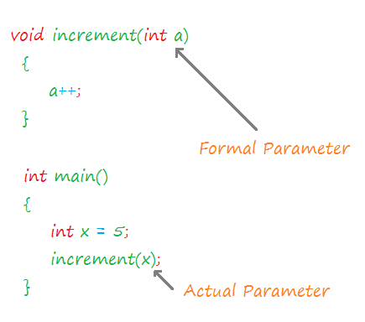
Call by value, Call by reference and Call by address.

Slide 14
Call by value
When a function is called in the call by value, the value of the actual parameters is copied into formal parameters.
Both the actual and formal parameters have their own copies of values, therefore any change in one of the types of parameters will not be reflected by the other.
This is because both actual and formal parameters point to different locations in memory (i.e. they both have different memory addresses).

Slide 15
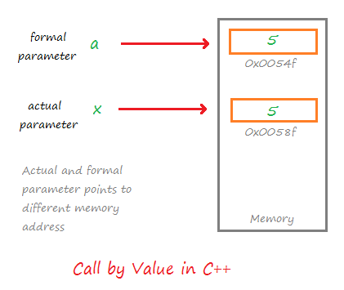
Call by value
Call by value method is useful when we do not want the values of the actual parameters to be changed by the function that has been invoked.

Slide 16
Call by value
#include <iostream>
using namespace std;
//Value of x gets copied into a
void increment(int a){
a++;
cout << "Value in Function increment: "<< a <<endl;
}
int main()
{
int x = 5;
increment(x);
cout << "Value in Function main: "<< x <<endl;
return 0;
}

Slide 17
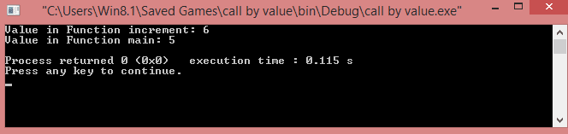
Call by value
Note the output of the program. The value of ‘a’ has been increased to 6, but the value of ‘x’ in the main method remains the same.
This proves that the value is being copied to a different memory location in the call by value.

Slide 18
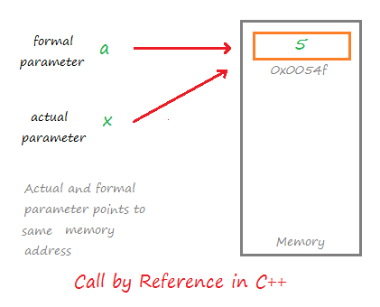
Call by Reference
In the call by reference, both formal and actual parameters share the same value.
Both the actual and formal parameter points to the same address in the memory.

Slide 19
Call by Reference
That means any change on one type of parameter will also be reflected by other.
Calls by reference are preferred in cases where we do not want to make copies of objects or variables, but rather we want all operations to be performed on the same copy.

Slide 20
Call by Reference Example
#include <iostream>
using namespace std;
//Value of x is shared with a
void increment(int &a){
a++;
cout << "Value in Function increment: "<< a <<endl;
}
int main()
{
int x = 5;
increment(x);
cout << "Value in Function main: "<< x <<endl;
return 0;
}
.

Slide 21
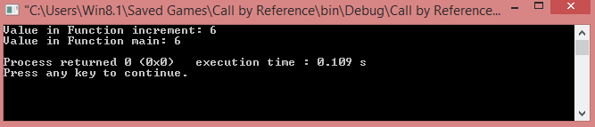
Call by Reference Example

Slide 22
Call by Address
In the call by address method, both actual and formal parameters indirectly share the same variable.
In this type of call mechanism, pointer variables are used as formal parameters.
The formal pointer variable holds the address of the actual parameter, hence the changes done by the formal parameter is also reflected in the actual parameter.

Slide 23
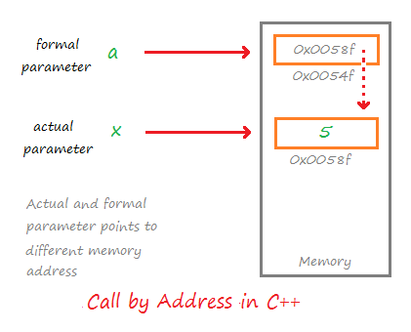
Call by Address

Slide 24
Call by Address
As demonstrated in the diagram, both parameters point to different locations in memory, but since the formal parameter stores the address of the actual parameter, they share the same value.
#include <iostream>
using namespace std;
//a stores the address of x
void increment(int *a){
(*a)++;
cout << "Value in Function increment: "<< *a <<endl;
}

Slide 25
Call by Address

Slide 26
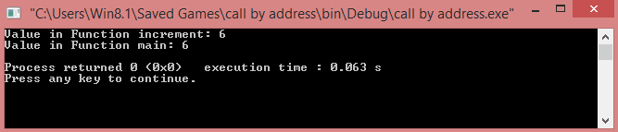
Call by Address
int main()
{
int x = 5;
increment(&x); //Passing address of x //int *a=&x;
cout << "Value in Function main: "<< x <<endl;
return 0;
}

Slide 27
Call by Address
int main()
{
int x = 5;
increment(&x); //Passing address of x
cout << "Value in Function main: "<< x <<endl;
return 0;
}

Slide 28
Conclusion
As a conclusion, we can say that call by value should be used in cases where we do not want the value of the actual parameter to be disturbed by other functions and call by reference and call by address should be used in cases where we want to maintain a variable or a copy of the object throughout the program.

Slide 29
Recursion
When function is called within the same function, it is known as recursion in C++. The function which calls the same function, is known as recursive function.
A function that calls itself, and doesn't perform any task after function call, is known as tail recursion. In tail recursion, we generally call the same function with return statement.

Slide 30
Recursion
When function is called within the same function, it is known as recursion in C++. The function which calls the same function, is known as recursive function.
A function that calls itself, and doesn't perform any task after function call, is known as tail recursion. In tail recursion, we generally call the same function with return statement.
recursionfunction(){
recursionfunction(); //calling self function
}

Slide 31
Recursion
When function is called within the same function, it is known as recursion in C++. The function which calls the same function, is known as recursive function.
A function that calls itself, and doesn't perform any task after function call, is known as tail recursion. In tail recursion, we generally call the same function with return statement.
recursionfunction(){
recursionfunction(); //calling self function
}

Slide 32
Recursion
#include<iostream>
using namespace std;
int main()
{
int factorial(int);
int fact,value;
cout<<"Enter any number: ";
cin>>value;
fact=factorial(value);
cout<<"Factorial of a number is: "<<fact<<endl;
return 0;
}

Slide 33
Recursion
int factorial(int n)
{
if(n<0)
return(-1); /*Wrong value*/
if(n==0)
return(1); /*Terminating condition*/
else
{
return(n*factorial(n-1));
}
}

Slide 34
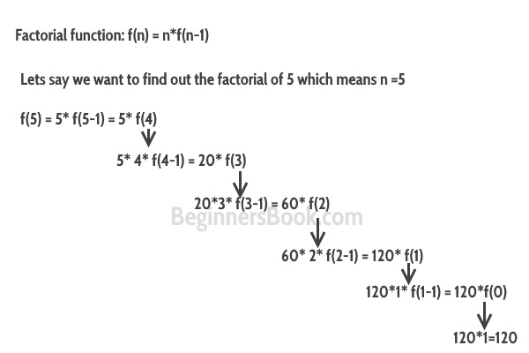
Recursion

Slide 35
Stack Overflow in Recursion
If the base case is not reached or not defined, then the stack overflow problem may arise. Let us take an example to understand this.
int fact(int n) { // wrong base case (it may cause // stack overflow). if (n == 100) return 1; else return n*fact(n-1); }

Slide 36
Stack Overflow in Recursion
If fact(10) is called, it will call fact(9), fact(8), fact(7) and so on but the number will never reach 100. So, the base case is not reached. If the memory is exhausted by these functions on the stack, it will cause a stack overflow error.

Slide 37
Advantage of Recursion
It makes our code shorter and cleaner.
Recursion is required in problems concerning data structures and advanced algorithms, such as Graph and Tree Traversal.

Slide 38
Disadvantage of Recursion
It takes a lot of stack space compared to an iterative program.
It uses more processor time.
It can be more difficult to debug compared to an equivalent iterative program.

Slide 39

QNA Time
Any Questions??
Any Questions ??

Slide 40
Thank You!
See you guys in next class.

